Slide 1
КАМПУС МОЛОДЁЖНЫХ ИННОВАЦИЙ
“КОНСТРУКТОР МИРОВ”
Большие Данные и Машинное Обучение
Лекция 2 : Матрицы и векторы
Data Science Engineer Фатыхов Тимур

Slide 2
Вектор
Матрица
(57, 0, 2, 17, 91)
3.2 | 24 | 19
91 | -2 | 4
-13 | 0.3 | -10
3
3

Slide 3
(-2, 2) + (1, 1) = ?

Slide 4
(-2, 2) + (1, 1) = (-1, 3)

Slide 5
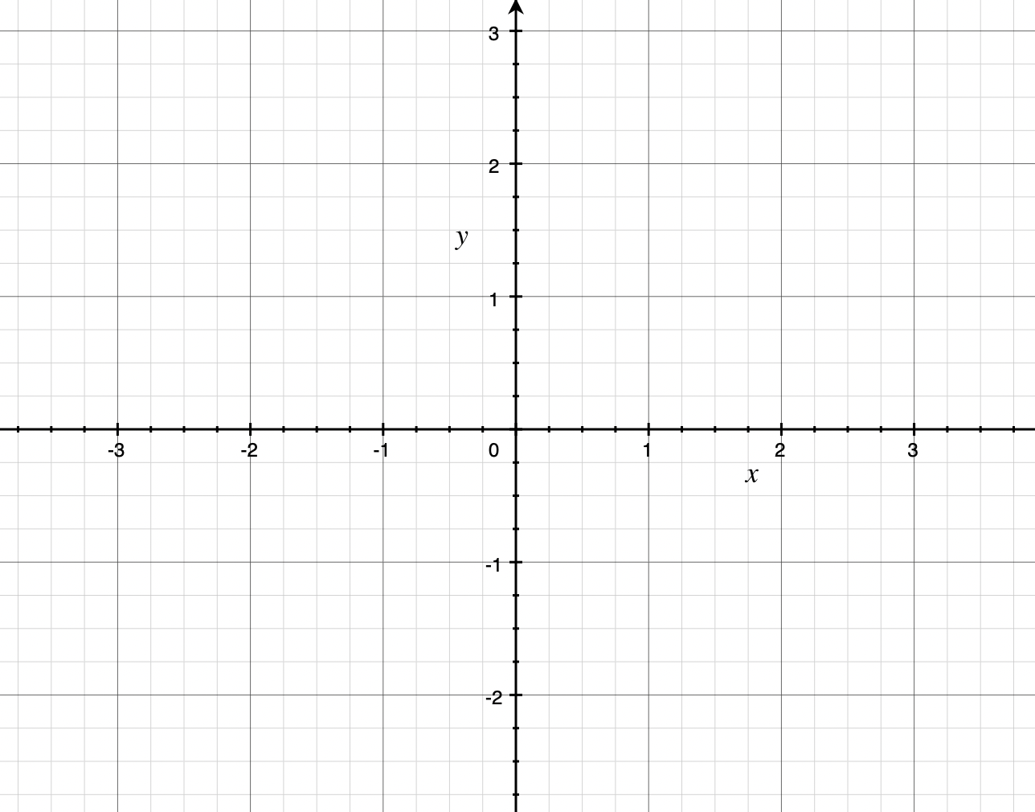
(-2, 2) + (1, 1) = (-1, 3)

Slide 6
(-2, 2) + (1, 1) = (-1, 3)

Slide 7
(-2, 2) + (1, 1) = (-1, 3)

Slide 8
3 x 2 = 2 + 2 + 2 = 3 + 3

Slide 9
(-2, 2) x (0, 1) = ?

Slide 10
(-2, 2) x (0, 1) = ?

Slide 11
(-2, 2) x (0, 1) = 2

Slide 12
(-2, 2) x (0, 1) = 2

Slide 13
(-2, 2) x (0, 1) = -2 * 0 + 2 * 1 = 2

Slide 14
3 | 2 | 0
1 | -2 | -2
5 | -1 | 0
1 | 0 | -1
3 | -4 | 2
0 | 5 | 3
+
=
?

Slide 15
3 | 2 | 0
1 | -2 | -2
5 | -1 | 0
1 | 0 | -1
3 | -4 | 2
0 | 5 | 3
3+1 | 2+0 | 0-1
1+3 | -2-4 | -2+2
5+0 | -1+5 | 0+3
+
=

Slide 16
3 | 2 | 0
1 | -2 | -2
5 | -1 | 0
1 | 0 | -1
3 | -4 | 2
0 | 5 | 3
4 | 2 | -1
4 | -6 | 0
5 | 4 | 3
+
=

Slide 17
3 | 2 | 0
1 | -2 | -2
5 | -1 | 0
1 | 0 | -1
3 | -4 | 2
0 | 5 | 3
? | ? | ?
? | ? | ?
? | ? | ?
X
=

Slide 18
(3, 2, 0) x (1, 3, 0) = 3 * 1 + 2 * 3 + 0 * 0 = 9
3 | 2 | 0
1 | -2 | -2
5 | -1 | 0
1 | 0 | -1
3 | -4 | 2
0 | 5 | 3
9 | ? | ?
? | ? | ?
? | ? | ?
X
=

Slide 19
(3, 2, 0) x (0, -4, 5) = 3 * 0 + 2 * -4 + 0 * 5 = -8
3 | 2 | 0
1 | -2 | -2
5 | -1 | 0
1 | 0 | -1
3 | -4 | 2
0 | 5 | 3
9 | -8 | ?
? | ? | ?
? | ? | ?
X
=

Slide 20
(3, 2, 0) x (-1, 2, 3) = 3 * -1 + 2 * 2 + 0 * 3 = 1
3 | 2 | 0
1 | -2 | -2
5 | -1 | 0
1 | 0 | -1
3 | -4 | 2
0 | 5 | 3
9 | -8 | 1
? | ? | ?
? | ? | ?
X
=

Slide 21
(1, -2, -2) x (1, 3, 0) = 1 * 1 + -2 * 3 + -2 * 0 = -5
3 | 2 | 0
1 | -2 | -2
5 | -1 | 0
1 | 0 | -1
3 | -4 | 2
0 | 5 | 3
9 | -8 | 1
-5 | ? | ?
? | ? | ?
X
=

Slide 22
3 | 2 | 0
1 | -2 | -2
5 | -1 | 0
1 | 0 | -1
3 | -4 | 2
0 | 5 | 3
9 | -8 | 1
-5 | -2 | ?
? | ? | ?
X
=

Slide 23
3 | 2 | 0
1 | -2 | -2
5 | -1 | 0
1 | 0 | -1
3 | -4 | 2
0 | 5 | 3
9 | -8 | 1
-5 | -2 | -11
? | ? | ?
X
=

Slide 24
3 | 2 | 0
1 | -2 | -2
5 | -1 | 0
1 | 0 | -1
3 | -4 | 2
0 | 5 | 3
9 | -8 | 1
-5 | -2 | -11
-2 | ? | ?
X
=

Slide 25
3 | 2 | 0
1 | -2 | -2
5 | -1 | 0
1 | 0 | -1
3 | -4 | 2
0 | 5 | 3
9 | -8 | 1
-5 | -2 | -11
-2 | 4 | ?
X
=

Slide 26
3 | 2 | 0
1 | -2 | -2
5 | -1 | 0
1 | 0 | -1
3 | -4 | 2
0 | 5 | 3
9 | -8 | 1
-5 | -2 | -11
-2 | 4 | -7
X
=

Slide 27
3 | 2 | 0
1 | -2 | -2
5 | -1 | 0
1 | 0 | -1
3 | -4 | 2
0 | 5 | 3
9 | -8 | 1
-5 | -2 | -11
-2 | 4 | -7
X
=

Slide 28
-1 | 2
3 | -2
3 | 2
1 | -2
1 | 0
0 | -4
X
=
?
0 | 1

Slide 29
-1 | 2
3 | -2
3 | 2
1 | -2
1 | 0
0 | -4
X
=
?
0 | 1
2 x 4
3 x 4
3 x 2

Slide 30
? | ?
? | ?
-1 | 2
3 | -2
? | ?
? | ?
3 | 2
1 | -2
1 | 0
0 | -4
X
=
0 | 1
? | ?
? | ?
2 x 4
3 x 2
3 x 4

Slide 31
-1 | ?
? | ?
-1 | 2
3 | -2
? | ?
? | ?
3 | 2
1 | -2
1 | 0
0 | -4
X
=
0 | 1
? | ?
? | ?
2 x 4
3 x 2
3 x 4

Slide 32
-1 | -6
? | ?
-1 | 2
3 | -2
? | ?
? | ?
3 | 2
1 | -2
1 | 0
0 | -4
X
=
0 | 1
? | ?
? | ?
2 x 4
3 x 2
3 x 4

Slide 33
-1 | -6
? | ?
-1 | 2
3 | -2
-1 | ?
? | ?
3 | 2
1 | -2
1 | 0
0 | -4
X
=
0 | 1
? | ?
? | ?
2 x 4
3 x 2
3 x 4

Slide 34
-1 | -6
? | ?
-1 | 2
3 | -2
-1 | -8
? | ?
3 | 2
1 | -2
1 | 0
0 | -4
X
=
0 | 1
? | ?
? | ?
2 x 4
3 x 2
3 x 4

Slide 35
?
-1 | -6
? | ?
-1 | 2
3 | -2
-1 | -8
? | ?
3 | 2
1 | -2
1 | 0
0 | -4
X
=
0 | 1
? | ?
? | ?
2 x 4
3 x 2
3 x 4

Slide 36
-1 | -6
? | ?
-1 | 2
3 | -2
-1 | -8
3 | ?
3 | 2
1 | -2
1 | 0
0 | -4
X
=
0 | 1
? | ?
? | ?
2 x 4
3 x 2
3 x 4

Slide 37
-1 | -6
7 | 2
-1 | 2
3 | -2
-1 | -8
3 | 8
3 | 2
1 | -2
1 | 0
0 | -4
X
=
0 | 1
1 | -2
0 | -4
2 x 4
3 x 2
3 x 4

